Slide 1
Task-oriented interactions in Microsoft Teams with messaging extensions
Notes:
Link unfurling is the process of taking a hyperlink pasted into a message and performing some action based on the result of processing the link. This process allows developers to perform a search, or display a card.

Slide 2

Overview
Unfurling links
Implementing link unfurling message handlers
Notes:
In this unit, you’ll learn how to add link unfurling to your Microsoft Teams app and how to implement this type of messaging extension.

Slide 3
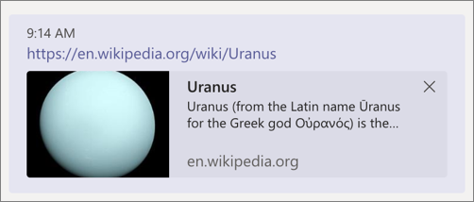
What is link unfurling?
Configure your messaging extension to watch for specific URLs in the compose message box
When a registered domain is detected, the message is sent to your web service
Web service responds with a richly formatted card, similar to search results
Notes:
With link unfurling your app can register to receive an `invoke` activity when URLs with a particular domain are pasted into the compose message area. The `invoke` will contain the full URL that was pasted into the compose message area, and you can respond with a card the user can unfurl, providing additional information or actions. This works similarly to a search command, with the URL serving as the search term.

Slide 4
Register link unfurling messaging extensions in the app manifest
"composeExtensions": [
{
"botId": "<REPLACE_WITH_MICROSOFT_APP_ID>",
"canUpdateConfiguration": false,
”messageHandlers": [
{
"type": ”link",
”type": { “domains”: [ ”*.wikipedia.org"]
}
]
}
],
“validDomains”: [ “{{HOSTNAME}}”, “*.wikipedia.org”]
Notes:
Adding a link unfurling messaging extension follows a similar process as action commands and search commands. You'll first register domain(s) supported by your messaging extension and then implement the handler in your web service.
The first step is to register your link unfurling messaging extension in your Microsoft Teams app manifest file. Do this by adding an entry to the `messageHandlers` property on the `composeExtensions` property.
The `type` property must be set to `link`.
The `value` property must contain a `domains` collection of domains that the link message handler watches for. If a link is added to a message that matches a domain listed in this collection, the message handler is invoked.
In addition to the `messageHandlers` property, all domains must also be listed in the `validDomains` property of the Microsoft Teams app's manifest.

Slide 5
Responding to message handler invocation
export class PlanetBot extends TeamsActivityHandler {
// handle the Activity type = “composeExtension/queryLink”
protected handleTeamsAppBasedLinkQuery(
context: TurnContext,
query: AppBasedLinkQuery): Promise<MessagingExtensionResponse> {
// get the selected planet
const selectedPlanet: any = planets.filter((planet) => planet.wikiLink === query.url)[0];
const adaptiveCard = this.getPlanetDetailCard(selectedPlanet);
// generate the response
return Promise.resolve(<MessagingExtensionActionResponse>{
composeExtension: {
type: "result", attachmentLayout: "list", attachments: [adaptiveCard]
}
});
} }
Notes:
When a valid domain is detected by the Microsoft Teams client, the Bot Framework will send an `Activity` object to your web service of type `composeExtension/queryLink` with the URL from the message.
Your web service will respond with a similar response as the search command. However, if you return multiple attachments, only the first one in the collection will be used by the Microsoft Teams client

Slide 6
Demo

Slide 7
Thank you.

